Slide 1
Jan 9 Sprint
8.0

Slide 2
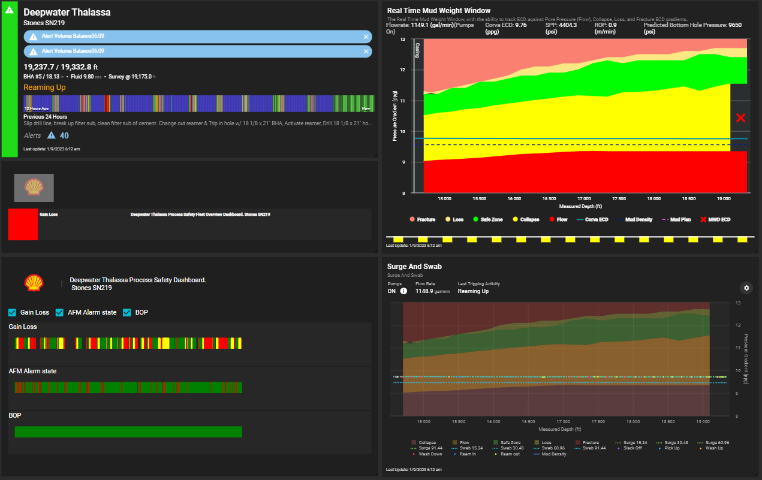
Thalassa
Up and running!
Fleet overview
APP text to small
Move or Remove Shell Pectin
Fix color on Pectin

Slide 3
Dynamic Positioning
Measures the health of the Vessels power, engines, and location systems
To assess Dynamic position, need some details to be added into system
Vessel/ Work Unit are not well specific and can change
Well Specific details update every well
Vessel
Number of Generators
Number of Thrusters
Generator Maximum Power (kW)
Generator Degraded %
Generator Emergency %
Thruster Power output (kW)
Thruster Degraded %
Thruster Emergency %
Well specific
DP Set Point Latituded
DP Set Point Longitude
DP Set Heading
Water Depth

Slide 4
Actions
Fleet overview - Nitish
APP text to small
Move or Remove Shell Pectin
Fix color on Pectin
Engage corva on best way to input “set up” data for vessel and well – Tyler
Create PPFG barrier stream using Main-Alert – Nitish/Mohd Asad
Flow and Fracture – Red
Collapse – Yellow
No alert – Green
24 hrs scale same as other Barrier data streams (BOP, AFM, GainLoss)
Dynamic position processing algorithms – Bolshoy
Request code for AFM from Misael/ Jerel - Tyler

Slide 5
Dynamic Position
Measures the health of the Vessels power, engines, and location systems
Data
Processing -TBD
Display
Fleet overview
Work Unit Process Safety Dashboard
Wits-DATA TAG | Source | Wits Address | Description | Logic
WITS_DATA_30_02 | GreenBee | 3002 | Port Switchboard (FS37)\Thruster 4 (Port Stern Thruster) Feeder (A02)\ Thruster 4 Active Power | Use
WITS_DATA_30_13 | GreenBee | 3013 | Port Switchboard (FS37)\Generator 1 (A06)\ Generator Active Power | Use
WITS_DATA_30_19 | GreenBee | 3019 | Port Switchboard (FS37)\Generator 2 (A07)\ Generator Active Power | Use
WITS_DATA_30_26 | GreenBee | 3026 | Port Switchboard (FS37)\Thruster 1 (Centre Bow Thruster) Feeder (A10)\ Thruster 1 Active Power | Use
WITS_DATA_30_35 | GreenBee | 3035 | Centre Switchboard (FS39)\Generator 1 (A02)\ Generator Active Power | Use
WITS_DATA_30_41 | GreenBee | 3041 | Centre Switchboard (FS39)\Generator 2 (A03)\ Generator Active Power | Use
WITS_DATA_30_45 | GreenBee | 3045 | Centre Switchboard (FS39)\Thruster 3 (Starboard Bow Thruster) Feeder (A04)\ Thruster 3 Active Power | Use
WITS_DATA_30_50 | GreenBee | 3050 | Centre Switchboard (FS39)\Thruster 6 (Centre Stern Thruster) Feeder (A07)\ Thruster 6 Active Power | Use
WITS_DATA_30_58 | GreenBee | 3058 | Starboard Switchboard (FS41)\Thruster 2 (Port Bow Thruster) Feeder (A02)\ Thruster 2 Active Power | Use
WITS_DATA_30_69 | GreenBee | 3069 | Starboard Switchboard (FS41)\Generator 1 (A06)\ Generator Active Power | Use
WITS_DATA_30_75 | GreenBee | 3075 | Starboard Switchboard (FS41)\Generator 2 (A07)\ Generator Active Power | Use
WITS_DATA_30_84 | GreenBee | 3084 | Starboard Switchboard (FS41)\Thruster 5 (Starboard Stern Thruster) Feeder (A11)\ Thruster 5 Active Power | Use
WITS_DATA_31_25 | GreenBee | 3125 | GPS Quality | if < 2, then Yellow
WITS_DATA_31_26 | GreenBee | 3126 | Number of Satellites in View | What is good?
WITS_DATA_31_27 | GreenBee | 3127 | Latitude Degrees (364000 feet) | Compare to DP set point
WITS_DATA_31_28 | GreenBee | 3128 | Longitude Degrees (364000 feet) | Compare to DP set point
WITS_DATA_31_29 | GreenBee | 3129 | Latitude Minutes (6068 ft) | Compare to DP set point
WITS_DATA_31_30 | GreenBee | 3130 | Longitude Minutes (6068 ft) | Compare to DP set point
WITS_DATA_31_55 | GreenBee | 3155 | Derived by Sniffer\ AKA Derived Value\ Vessel Operating in Fault Tolerant Configuration | Engaging AKA on details
WITS_DATA_31_57 | GreenBee | 3157 | Derived by Sniffer\AKA Derived Value\ Low Confidence in Data Logging System | Engaging AKA on details
WITS_DATA_31_62 | GreenBee | 3162 | Derived by Sniffer\AKA Derived Value\ Power Plant Utilization % | Engaging AKA on details
WITS_DATA_31_63 | GreenBee | 3163 | Derived by Sniffer\AKA Derived Value\ Plant Overloaded Alarm | Engaging AKA on details

Slide 7
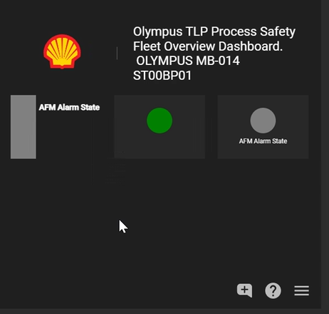
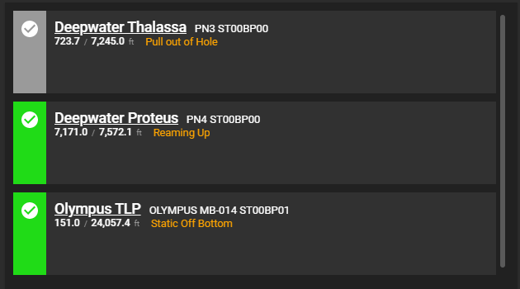

Fleet overview Visual

